Slide 1
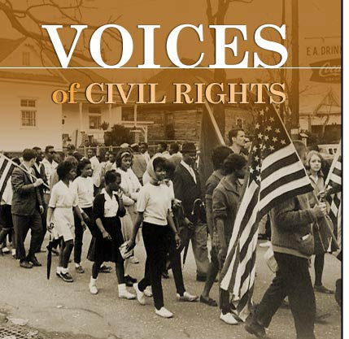
Civil Rights Movement

Slide 2
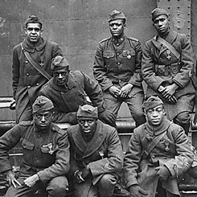
Post-WWII
African Americans grew dissatisfied with their second-class status after WWII
Risked their lives defending freedom abroad
Civil Rights Movement-a broad and diverse effort to attain racial equality
http://www.history.com/shows/america-the-story-of-us/videos/blacks-in-the-military#blacks-in-the-military

Slide 3
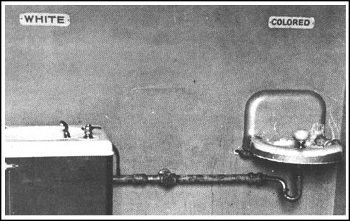
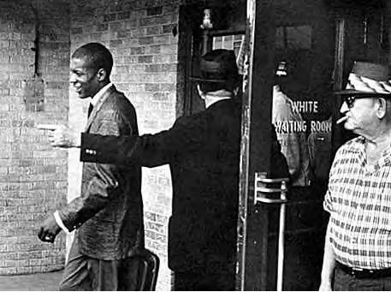
Segregation divides America
Jim Crow laws-enforced strict separation of the races in the South
Schools, hospitals, transportation, & restaurants
De jure segregation-imposed by law
1896 Plessy vs. Ferguson-”Separate but equal”

Slide 4
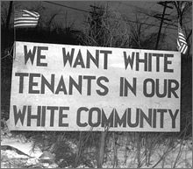
Segregation in the North
De facto segregation: segregated by unwritten custom or tradition, face of life
Blacks were denied housing in many neighborhoods and faced discrimination in employment (NORTH)

Slide 5
The Impact of Segregation
African Americans received low-paying jobs
Higher rates of poverty and illiteracy
Lower rates of homeownership and life expectancy
Couldn’t vote in the south

Slide 6
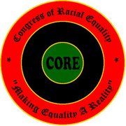
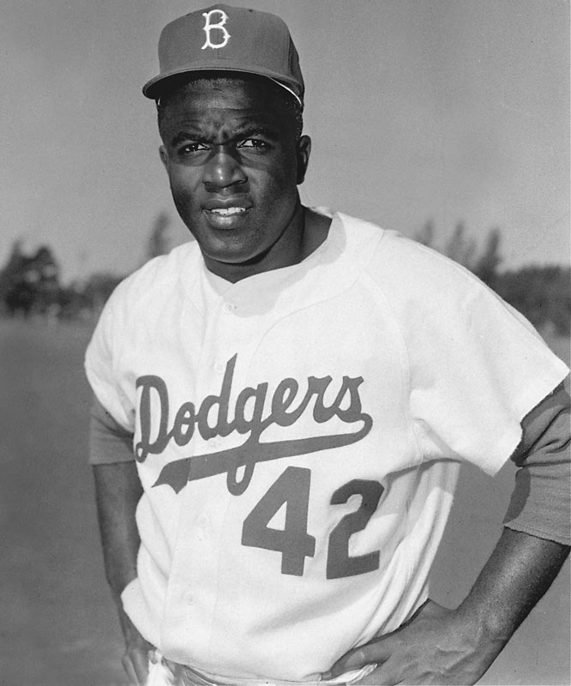
The Civil Rights Movement Grows
Congress of Racial Equality (CORE): became convinced to use non-violent methods to gain civil rights
Organized Protests in northern cities
Jackie Robinson
President Truman used his executive power to order the desegregation of the military

Slide 7
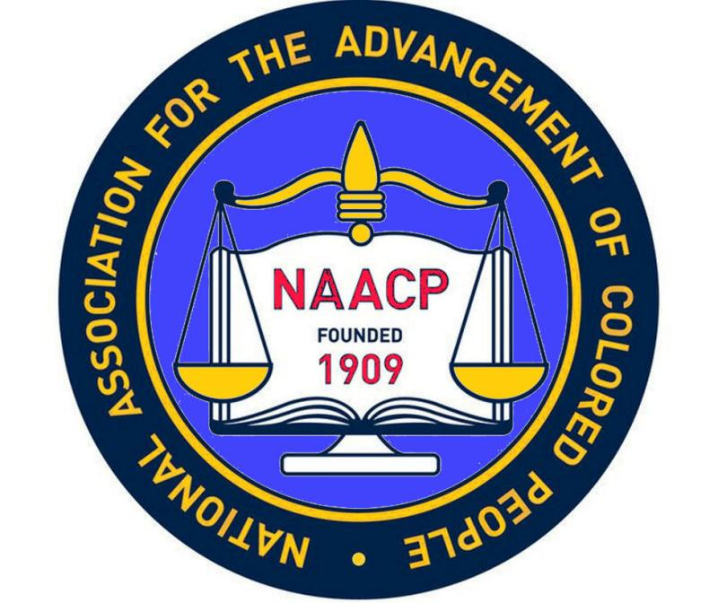
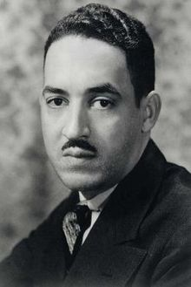
NAACP Challenges Segregation
NAACP became the largest and most powerful civil rights organization
Thurgood Marshal-headed the team that challenged the legality of segregation

Slide 8
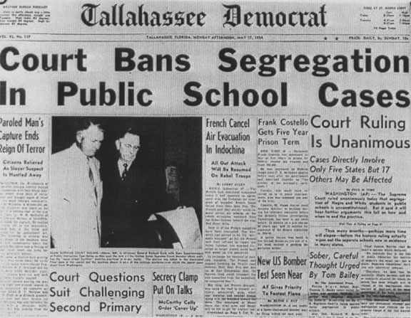
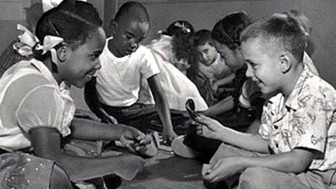
Brown vs. Board 1954
NAACP challenged the “separate but equal” ruling
The Supreme Court agreed with NAACP argument that segregated public education violated the U.S. Constitution
Effects:
Great impact since it touched so many Americans
Opposition to the ruling declared that the South would not be integrated (White Citizens Council)
http://www.history.com/videos/brown-vs-board-of-education-separate-is-not-equal#brown-vs-board-of-education-separate-is-not-equal

Slide 9
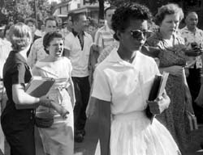
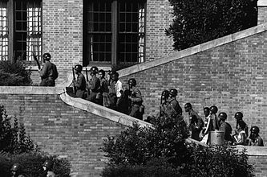
Little Rock Nine
President Eisenhower sent federal troops to Little Rock to protect the African American students and to enforce Brown vs. Board
For the entire school year, federal troops stayed in Little Rock escorting the students to and from school
http://www.history.com/videos/little-rock-9#little-rock-9

Slide 10
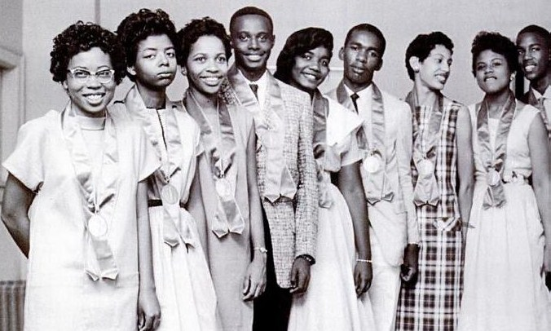
Effects of Little Rock Nine
It demonstrated that the President would not tolerate open defiance of the law
However, most southern states found ways to resist desegregation and it would take years before black and white children went to school together

Slide 11
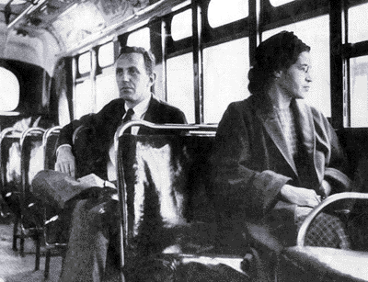
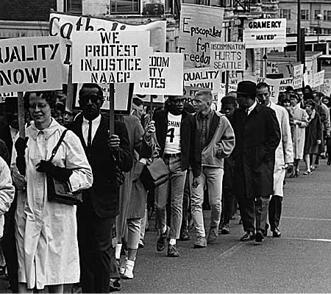
Montgomery Bus Boycott
Rosa Parks actions transformed the movement
NAACP began preparing a legal challenge
Rise of MLK: urged non-violence
Boycott lasted a year
In 1956 the Supreme Court ruled the Montgomery bus segregation law was unconstitutional

Slide 12
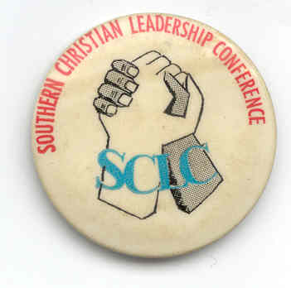
Effects of the Boycott and the Supreme Court Victory
Revealed the power African Americans could have if they joined together
King established the Southern Christian Leadership Conference (SCLC)
Advocated nonviolent resistance to fight injustice

Slide 13
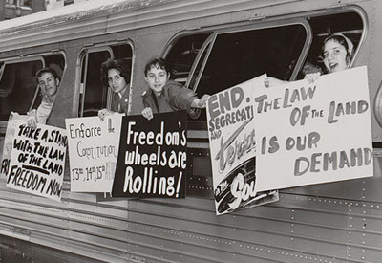
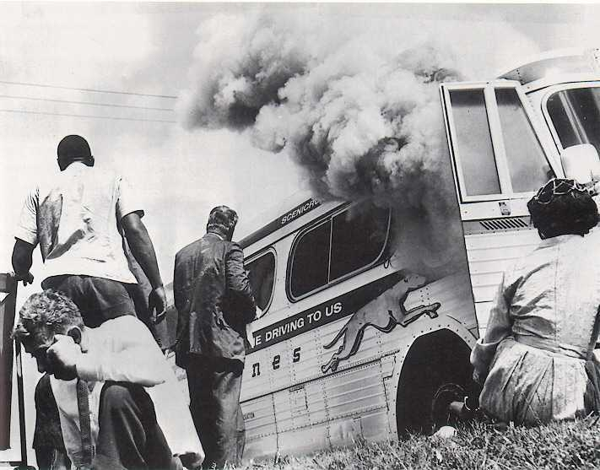
Freedom ride
Test the federal government’s willingness to enforce that segregation on interstate buses was illegal (Boynton v. Virginia 1960)
En route, they defied segregation codes
In Alabama firebombed one bus and attacked the riders of the second bus

Slide 14
Effects of the Freedom Ride
Kennedy takes action
Federal Transportation Commission issued an order mandating the desegregation of interstate transportation
Civil rights activists achieved their goal and that intimidation would not defeat them
http://video.pbs.org/video/1574363015/

Slide 16
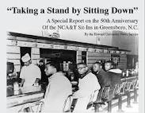
Sit-ins
Four black students at North Carolina sat down in a white diner and were told that they would not be served (First)
Sit ins became a new way to protest segregation of public facilities

Slide 17
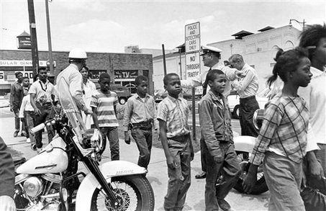
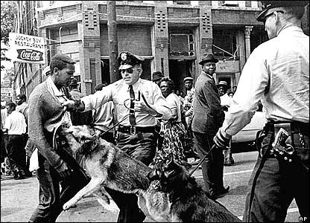
Focus on Birmingham
Letter from Birmingham jail by King
Freedom marches: schoolchildren joined the demonstrations
Many Americans were shocked by the news coverage of nonviolent protestors set upon by dogs and jets of water
Kennedy approves civil rights bill

Slide 18
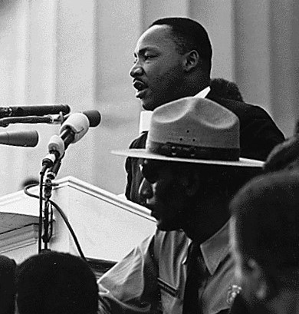
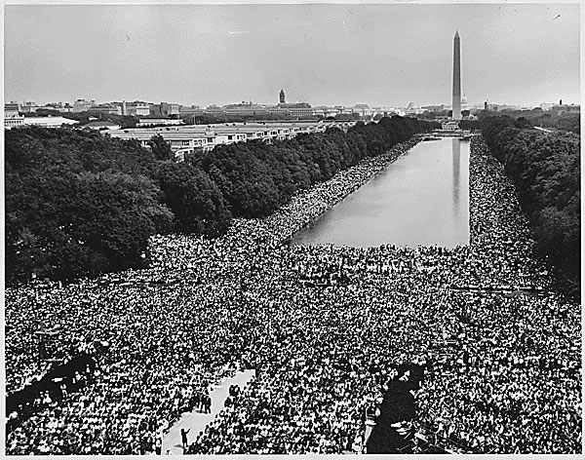
March on Washington
To put pressure on Congress to pass the new civil rights bill
Drew more than 200,000
MLK-”I have a dream”
One of the largest political demonstrations
A model for peaceful protest
http://www.history.com/videos/martin-luther-king-jr-leads-the-march-on-washington#martin-luther-king-jr-leads-the-march-on-washington

Slide 19
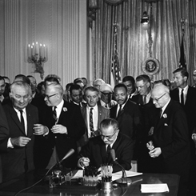
Civil Rights Act of 1964
The act banned segregation in public accommodations
Gave the federal government the ability to desegregate schools
Prosecute individuals who violated people’s civil rights
Outlawed discrimination in employment
Established the Equal Employment Opportunity Commission (EEOC)
http://www.history.com/videos/civil-rights-act-of-1964#civil-rights-act-of-1964

Slide 20
The Push for Voting Rights
Literacy tests
Poll taxes
Intimidation
All kept blacks from voting

Slide 21
Voting Rights Act of 1965
Spurred by actions of protesters and the President, Congress passed the act
It banned literacy tests and empower the federal gov to oversee voting registration
By 1975, Congress extended to Hispanic voters
Black participation jumped from 7% in 1964 to 70% in 1986

Slide 22
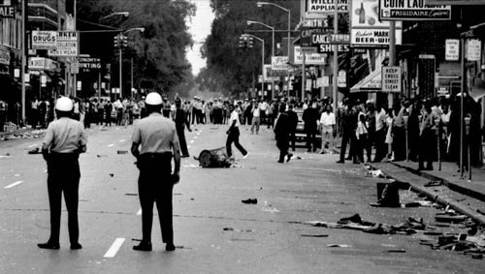
The Riots
Frustration over discrimination and poverty
Worst in Newark, New Jersey and Detroit, Michigan in the summer of 1967
Blacks using violence against police and white business owners in black neighborhoods

Slide 23
The Kerner Commission
It concluded racial discrimination as the cause of the violence
They recommended by extending federal programs to Urban black neighborhoods
Controversy surrounding the Commission
Johnson did not follow up

Slide 24
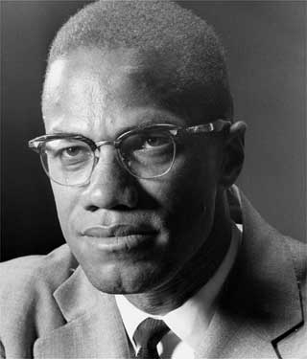
Malcolm X
Influenced by race riots
Difficult childhood
While in jail, converted to the Nation of Islam
Strict rules of behavior, no drugs or alcohol, and demanded a separation of the races

Slide 25
Malcolm X
He became the Nation of Islam’s most prominent minister
However, he broke away and formed his own
Three members were later convicted of assassinating Malcolm
After his pilgrimage to Mecca, Malcolm was more willing to consider limited acceptance of whites

Slide 26
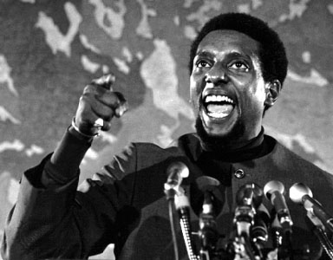
“Black Power”
Move away from nonviolence
Stokley Carmichael’s definition: it meant African Americans should collectively use their economic and political muscle to gain equality
Institutional Racism
http://www.history.com/videos/stokely-carmichael#stokely-carmichael

Slide 27
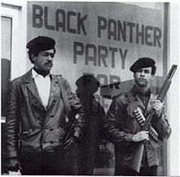
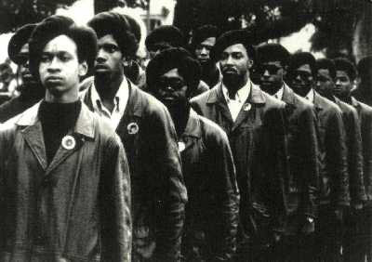
Black Panthers
Symbol of young militant African Americans
Protected urban neighborhoods from police abuse
Created antipoverty programs
Stokely was “honorary Prime Minister”

Slide 28
MLK’s final days
Understood the anger and frustration of many urban African Americans
Disagreed with the call for “black power”
King’s assassination triggered riots in more than 100 cities
2 months later Robert Kennedy was assasinated

Slide 29
Significant Gains
Eliminated legal or de jure segregation
Knocked down barriers of voting and political participation for African Americans
Poverty rates fell
Increase in the number of African Americans high school graduates
Appointment of Thurgood Marshall as the first African American Supreme Court Justice in 1967
Fair Housing Act

Slide 30
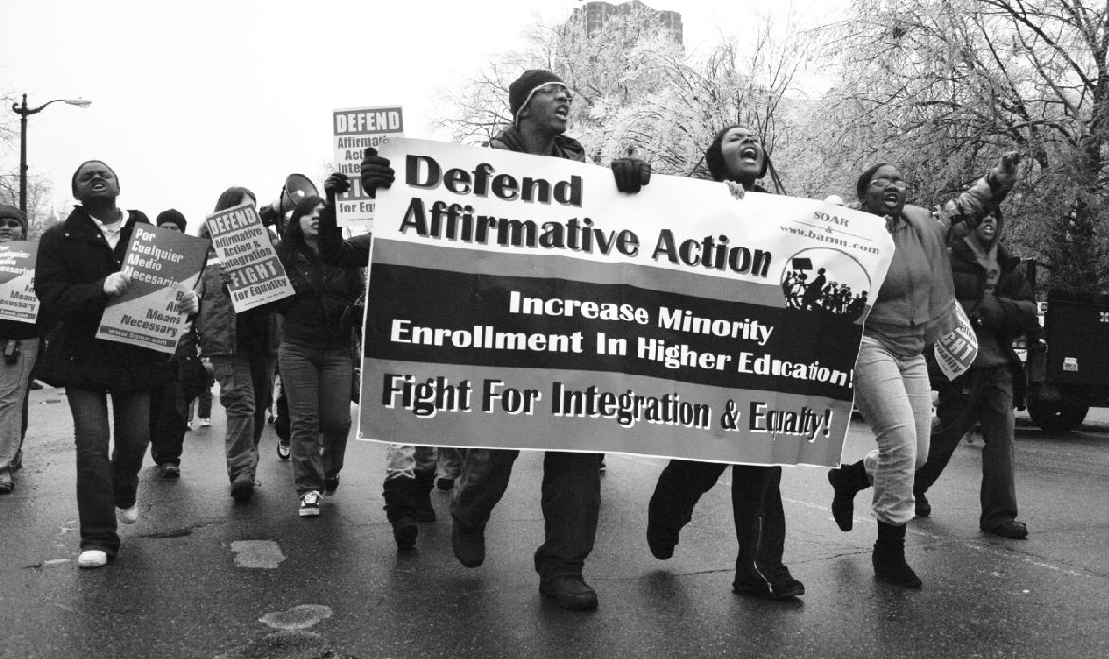
Controversial Issues
Affirmative Action: increase African American representation in schools and the workforce
Racism
Social and Economic gap

